Slide 1

Traffic Simulator
Bank
Amber St.
(6 miles)
James St.
(4 miles)
Jackson St.
(3 miles)
School
Travis St.
(3 miles)
Tulip St.
(3 miles)
Birch St.
(5 miles)
Mark and Simon

Slide 2
Data Structures
Car Struct
Stack
Road Class
Queues
Multi-Maps

Slide 3
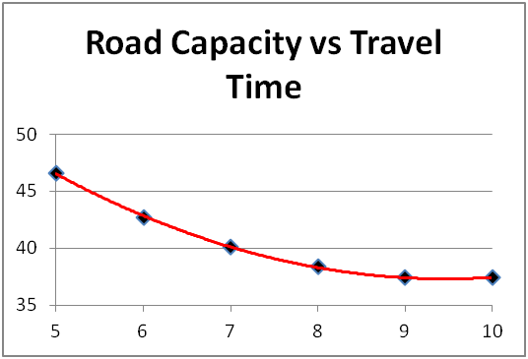

Slide 4
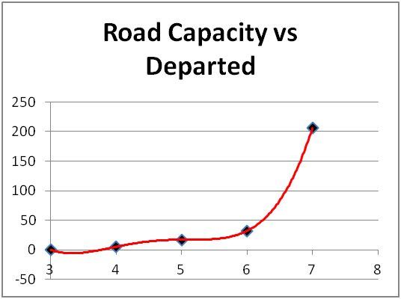

Slide 5
